Slide 1




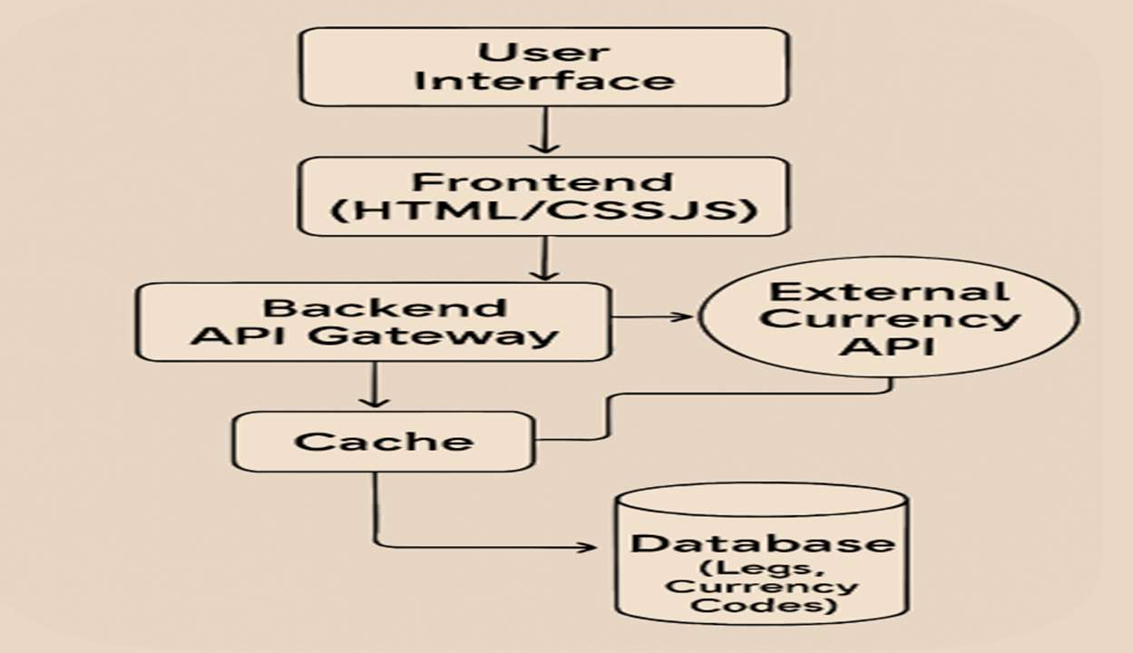
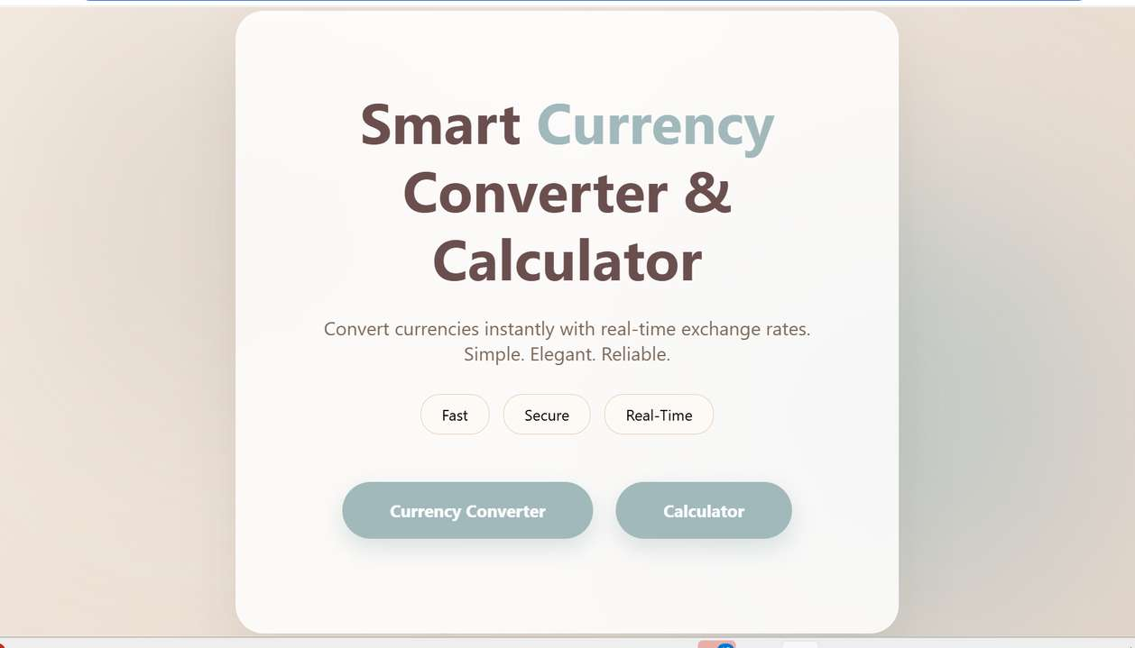


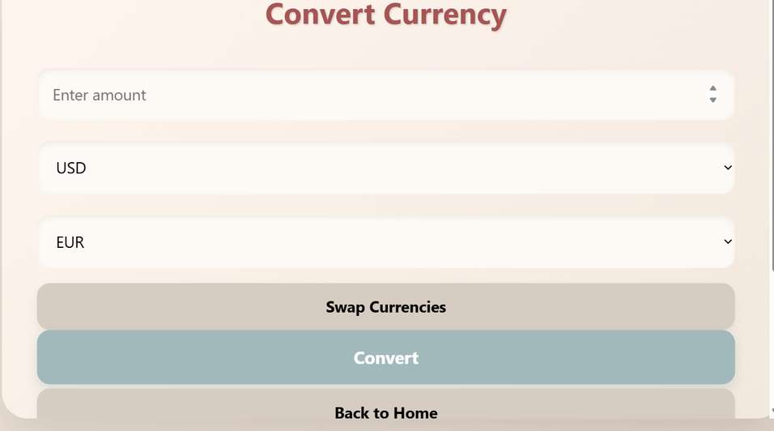
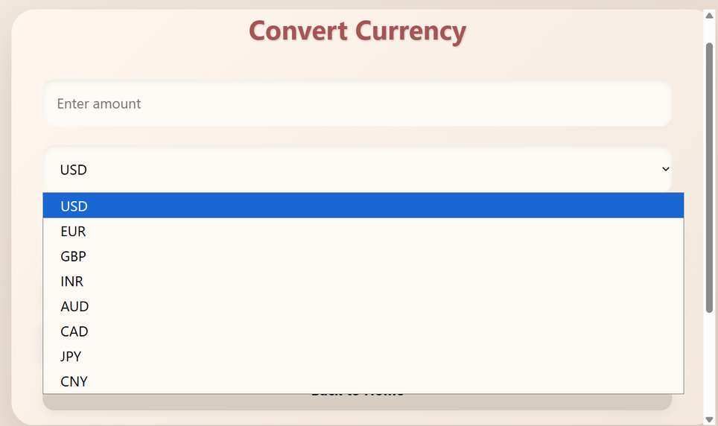
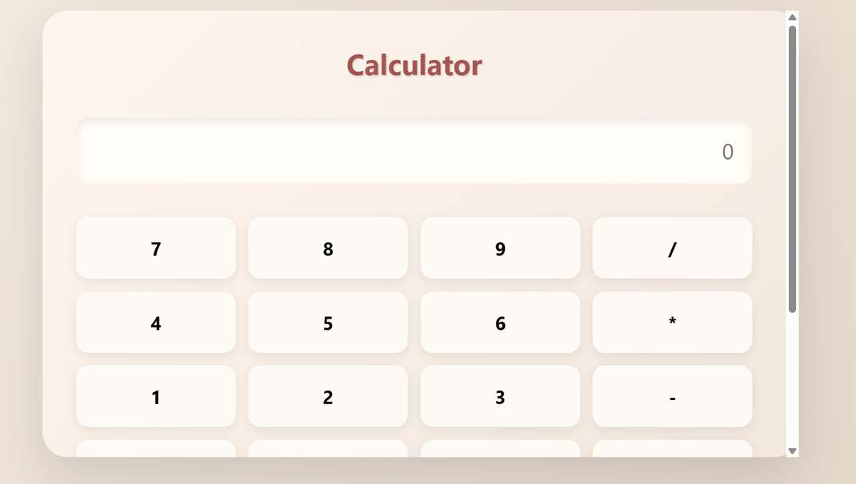
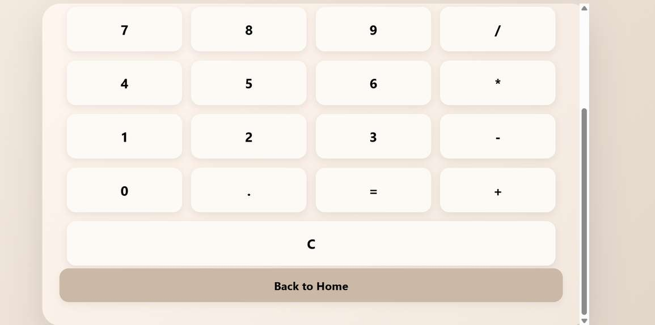

Currency Exchange Rate Calculator Tool
Project Based Learning From FWD
Abstract
System Architecture
•The Currency Converter Project is designed to provide users with a simple, efficient, and visually appealing platform to convert values between multiple currencies. Built using Core Java and enhanced with a graphical user interface (GUI), the application integrates both static conversion logic and live exchange rate API to ensure accurate and real-time results.A reliable converter helps users quickly calculate values across different currencies without manual effort. This project, Smart Global Currency Converter Tool, is designed to provide accurate, real-time conversions through a user-friendly interface. It combines Core Java programming concepts with API integration and a graphical user interface (GUI) to deliver technical robustness.
CO - WISE IMPLEMENTATION
CO1: Algorithm Analysis and Complexity
1. HTML Document Structure
2.Core CSS Styling
CO2 – HTML Forms & Input Handling
CO3 – JavaScript Programming Essentials
Focuses on structured content, advanced layouts, and responsive design
•Focuses on the core logic and data structures of the application.
CO4 – JavaScript Interactivity, DOM & Events
CO5 – Advanced Web Development & Deployment
•Covers how the app responds to users and interacts with browser storage.
•Highlights integration with external services and robust error handling.
Conclusion and Future Scope:
•This project successfully addresses the limitations of existing systems by combining static conversion logic with live exchange rate API integration.
•This hybrid approach ensures both accuracy and reliability, even in offline scenarios.
Name: Panapakam Hasini
Roll no: 2520030282
Section: 6
Cluster: 2

